Slide 1






CERBERUS – Biometric Attendance.

Slide 2
Cerberus - Live Project
Guide:
Mr. Krishnanand Rastogi
Team Members:
Ebenezer Isaac [522025]
Lokhandwala Haji Huseinali [522035]
Vraj R. Kotwala [522033]

Slide 3



1.
Project Summary
Let’s start with the first set of slides

Slide 4
Our project focuses on managing a distributed system of devices that are capable of scanning biometrics for the use of attendance for a large scope of stakeholders automatically on the basis of a timetable.

Slide 5
The student will be marked present through biometric (fingerprint) module and the attendance data can be accessed on our website by the users.

Slide 6
Flow-Chart of Arduino

Slide 7
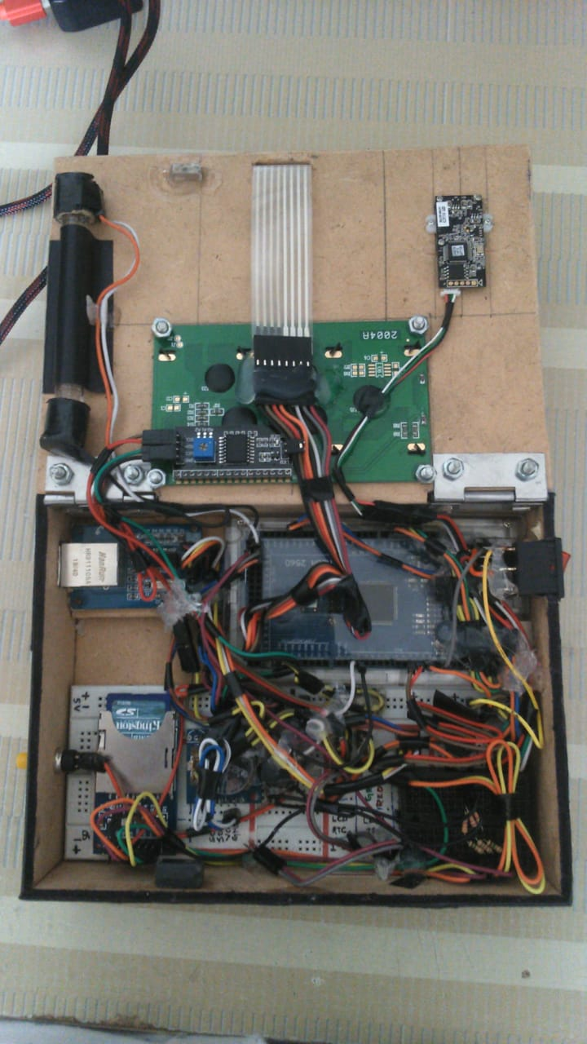
Complex wiring of Arduino

Slide 8








Agile Methodology
To iterate the development and testing throughout the software development lifecycle of the project.
Extreme programming (XP) is a software development practice which is intended to improve software quality and responsiveness to changing customer requirements.

Slide 9
Why we switched to Rpi
Feature | Arduino Mega | Rpi Zero
RAM | 8 KB | 512 MB
Download Speed | 16 MBPS | 10 MBPS
OS | - | Linux Raspbian
Multitasking | No | Yes
Price | 850 | 990
Download/Upload Templates from/to FPS.
Support for multiple SPI interface
Inbuilt SD card support

Slide 10
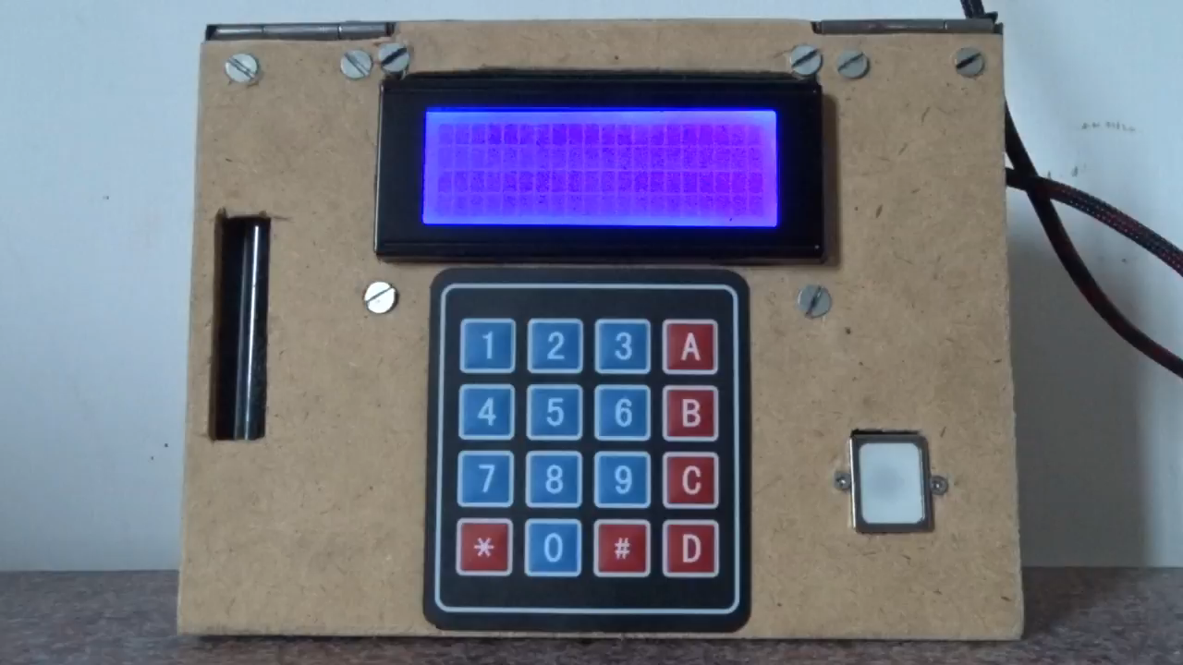
Demo of Rpi

Slide 11
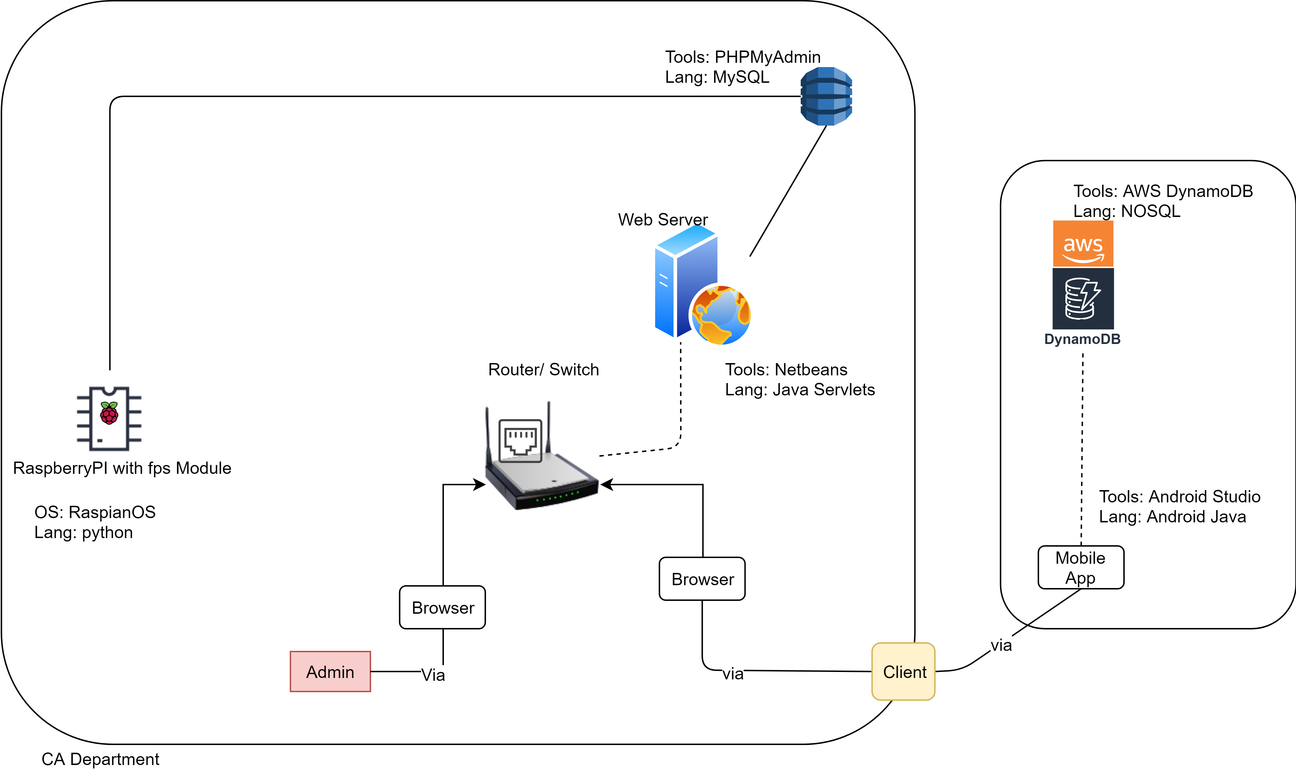
System Architecture

Slide 12
Scope of Device (w RaspberryPi)
Enroll fingerprints
Authentication
Manage Faculty/ Admin (Fingerprint data)
Manage Student (Fingerprint data)
Background Activities:
Sync:
Attendance to database
Fetch templates from database
Fetch timetable from database.
Fetch PRN

Slide 13
Scope of Web-App (made w Servlet)
For Faculty:
Login
Timetable Management
Subjects Management
Student Management
Attendance Management (Manual)
Admin Management
Student Progression
OTP for devices
Profile Management
For Students:
Login
View Attendance
Select Electives

Slide 14
Tools and Technology Used:
On Device (RaspberryPi):
OS: Raspbian
Lang: Python
Tool: Notepad++
On Web-App:
frontend:
AJAX, HTML, JS, CSS
backend:
Java-Servlet, JSP.
Database: MySQL
Server: Apache Tomcat 8.0

Slide 15
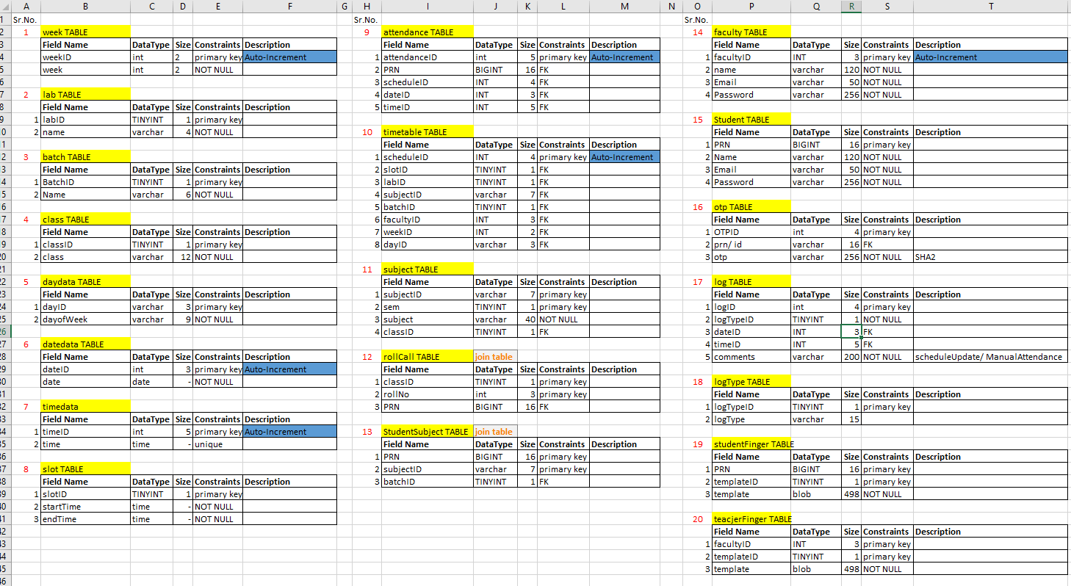
Tables of Database – (Data Dictionary)

Slide 16
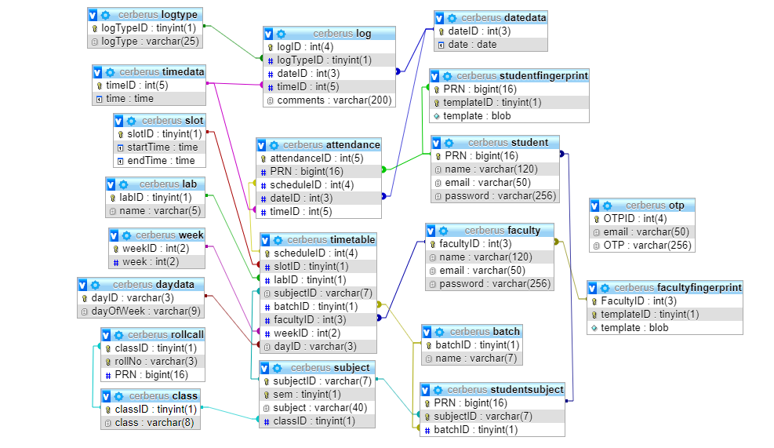
System Design – ERD (Relational)

Slide 17
PhpMyAdmin Demo with SQL

Slide 18
2.
Implementation
ScreenShots and Live Demo

Slide 19
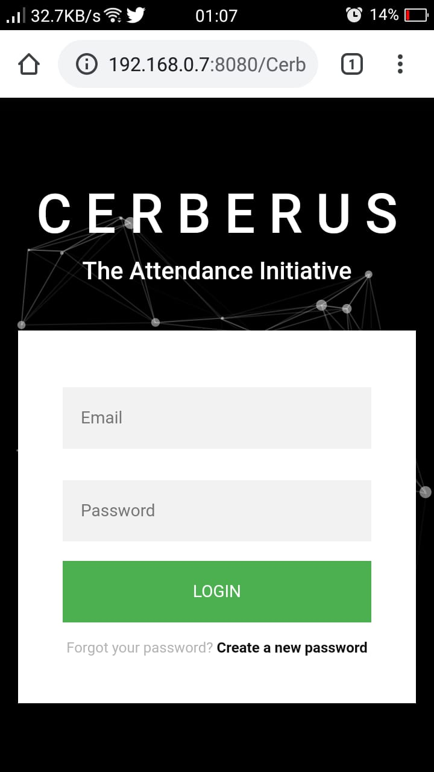
Mobile project
Perks of using Bootstrap - Index Page with Login
Place your screenshot here

Slide 20
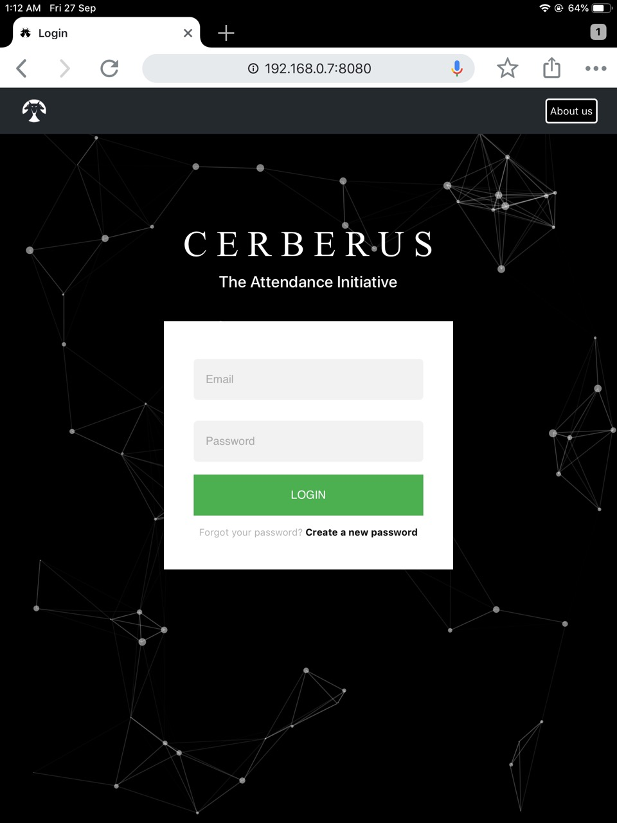
Tablet project
Index Page with Login
Place your screenshot here

Slide 21
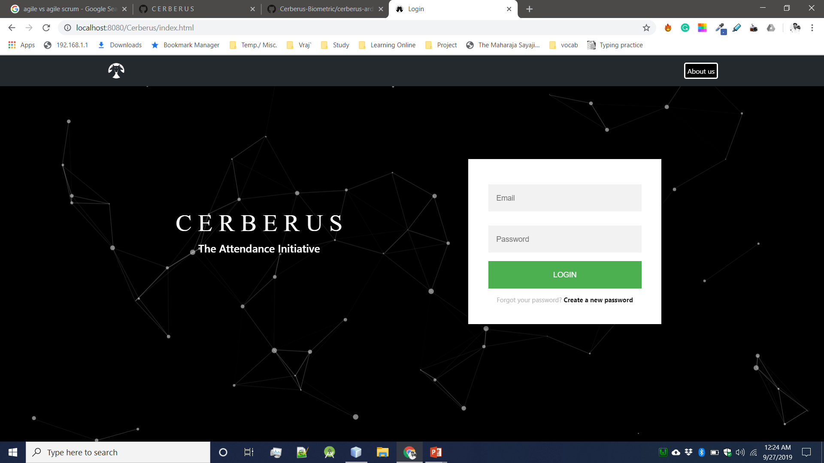
Desktop project (Web)
Index Page with Login
Place your screenshot here

Slide 22
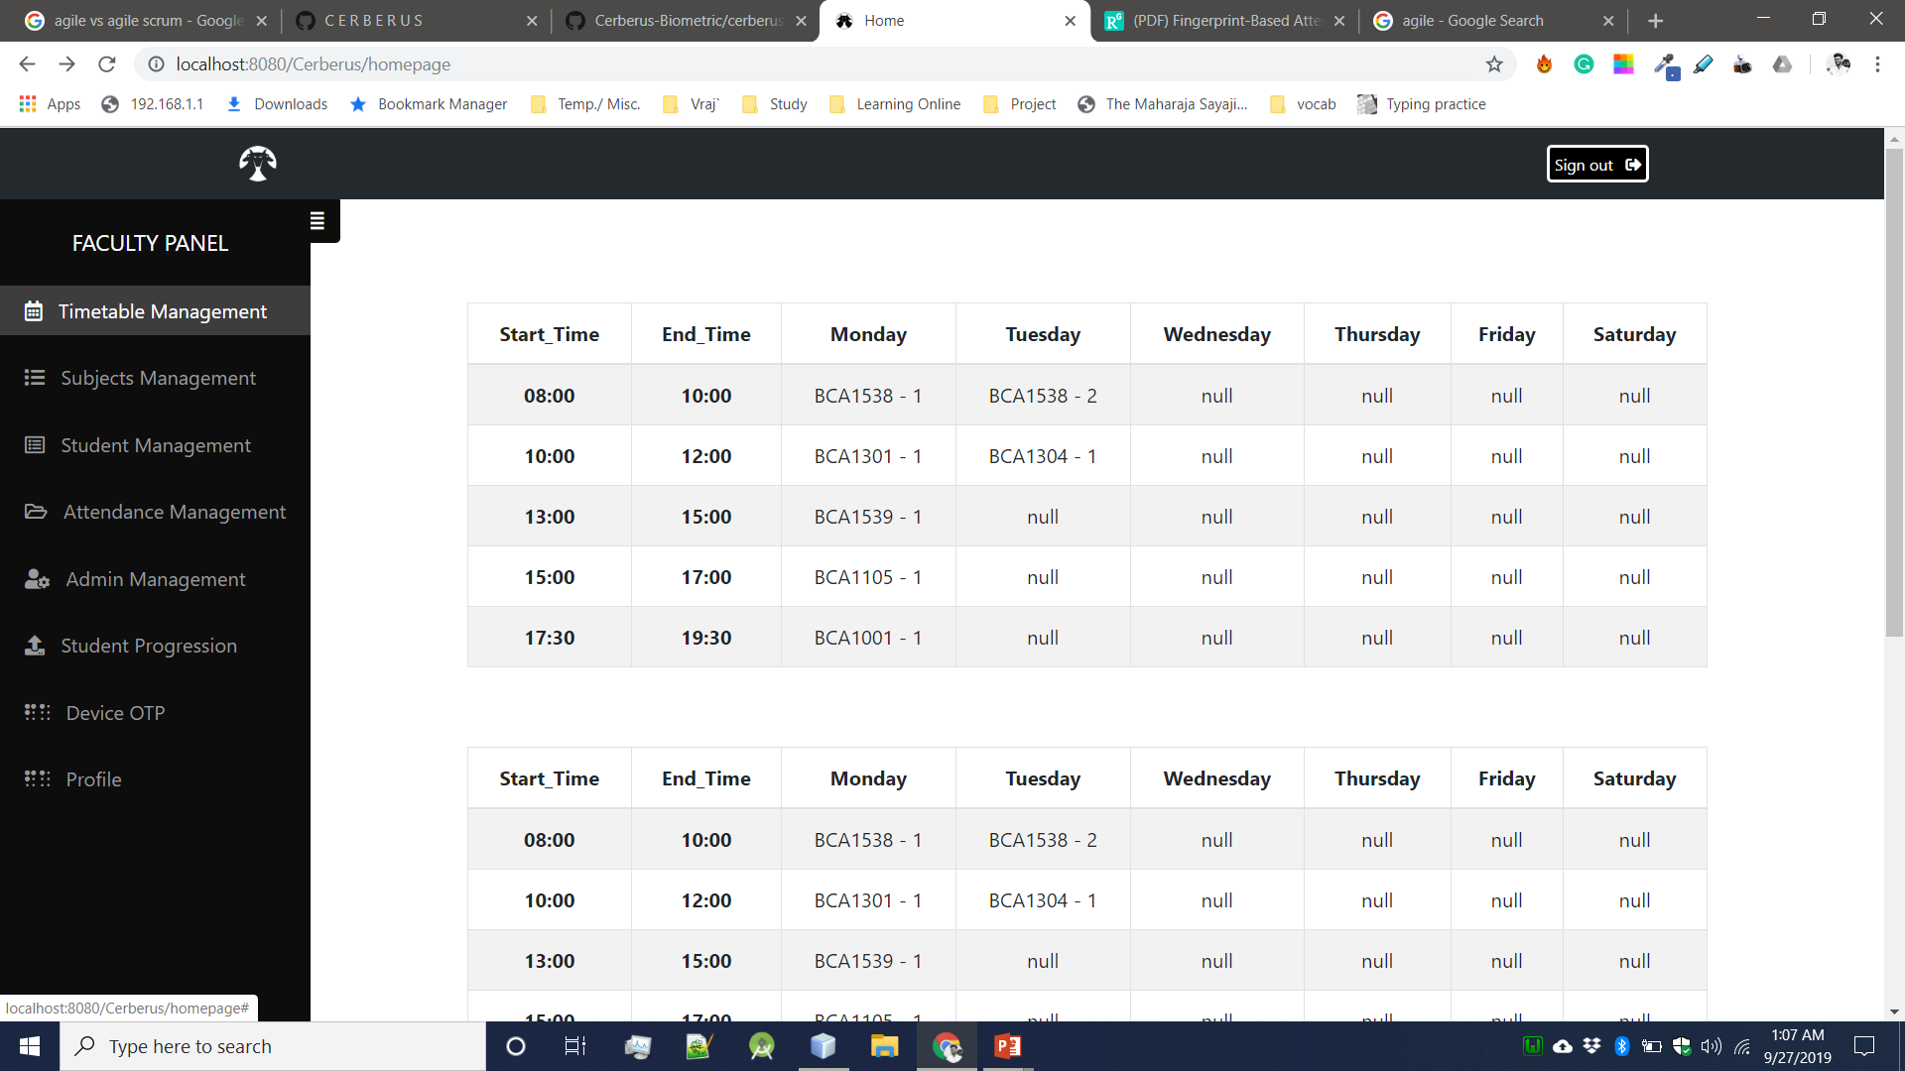
Desktop project (Web)
Home page when faculty logs In.
Place your screenshot here

Slide 23
Login and Forget password (OTP) Demo

Slide 24
GitHub Demo w User Stories

Slide 25
Hours Worked Excel File

Slide 26

Finance
Raspberry Pi | 990
FPS Module | 1640
Ethernet Module | 250
Buzzer | 15
RTC Module | 100
Battery Cell | 65
Touch Screen | 530
Perf Board | 25
Shipping Charges | 50
Misc. | 250
 | 3915

Slide 27
Project Work Division
Arduino and circuit design: Ebenezer and Vraj
RaspberryPi: Ebenezer
Box design: Ebenezer.
Backend: Ebenezer & Vraj
Front end & GUI: Huseinali
Database & SQL: Vraj
Documentation: Vraj
Testing: All 3 of us.
Mobile-App: Huseinali

Slide 28

Thank you!

